Slide 2
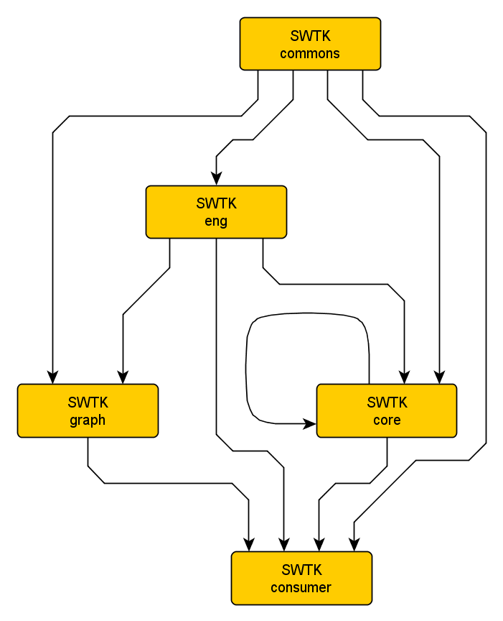
Deployment Process
JAR file deployment path

Slide 3
SWTK Core
Functionality:

Slide 4
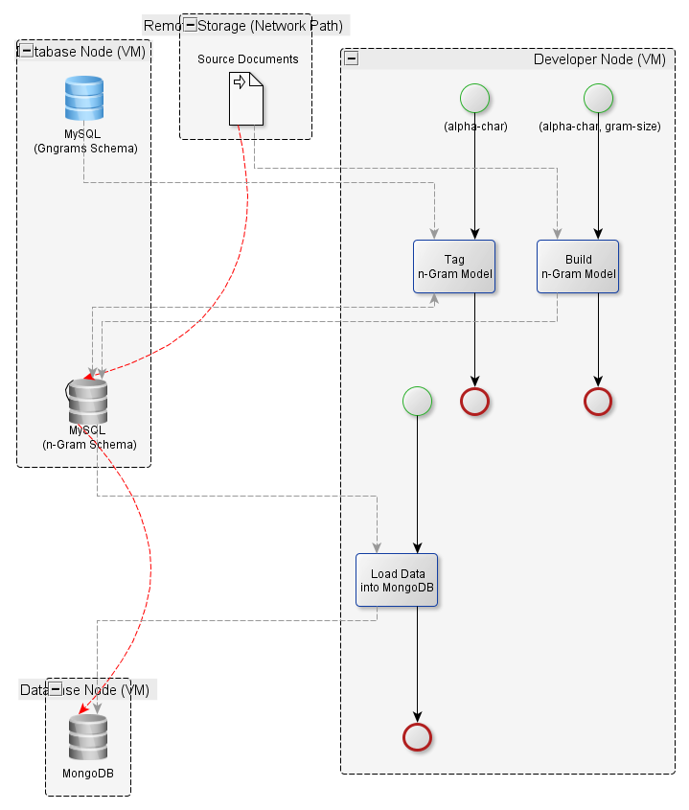
n-Grams
Classic Approach
Overview
  The Language Model is created on a single MySQL node and then loaded into MongoDB for runtime usage
Pros
  Easy – Just requires a MySQL DB instance which is easy to setup
Cons
  Does not scale
  The NYT dataset is considered moderate in size (5 GB) and takes about 6 hours to process a single gram size (e.g. trigrams)
Known Defects / Issues
  Memcached prevents duplicate caches being registered. This can be fixed by tweaking the configuration file
Notes:
The use of MongoDB is optional, but a JSON store lends itself to n-Gram analysis in a way that is far superior to a relational database.

Slide 5
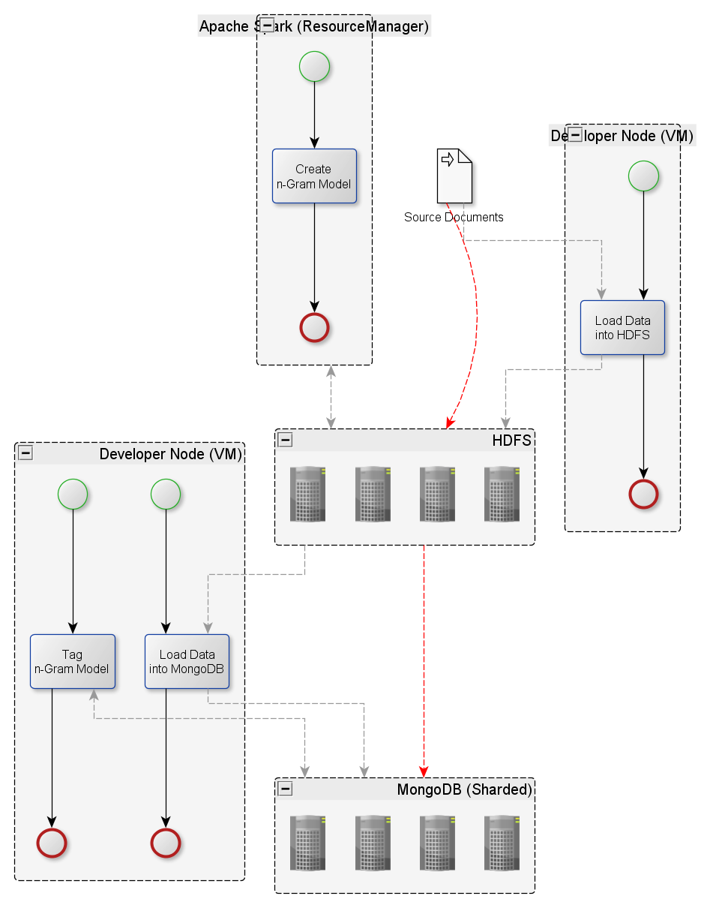
n-Grams
Scalable
Overview
  The Language Model is created in HDFS and then loaded into MongoDB
Pros
  Highly Scalable (scales as far as the HDFS cluster will permit)
Cons
  Requires dual clusters (HDFS and MongoDB)
  Higher Maintenance (are these scripts or Java classes?) and Higher Complexity
  Harder to step away and come back to this approach 6 months later and get it to work
Known Issues / Defects
  Not implemented yet

